Slide 1
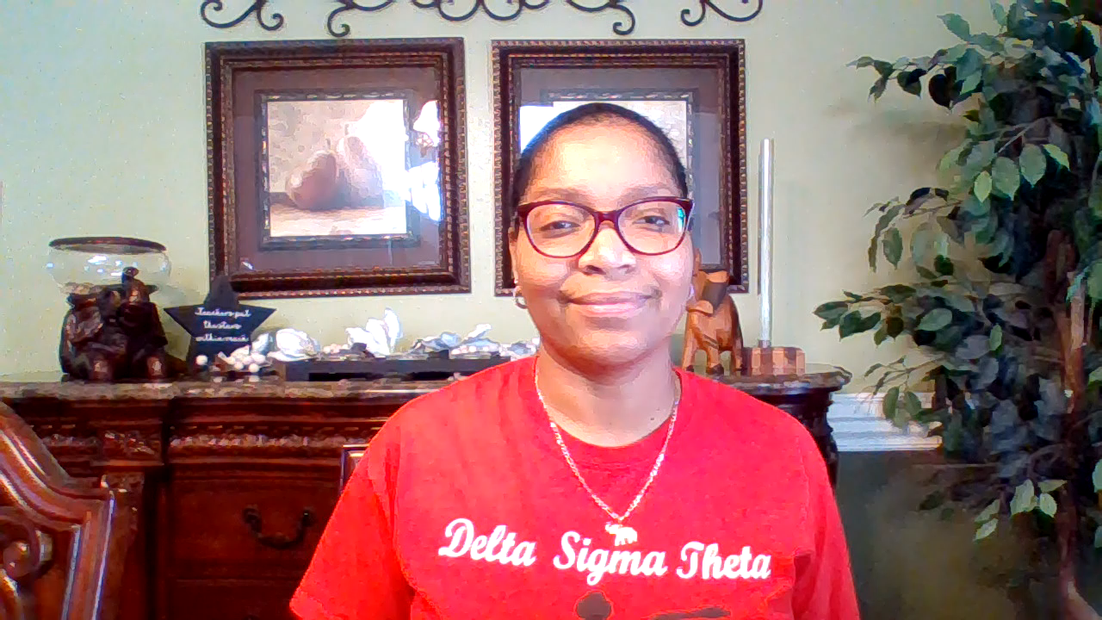
Rosalind Blake
Instructional Facilitator

Slide 2

Black History Month
Rosa Louise McCauley Parks

Slide 3
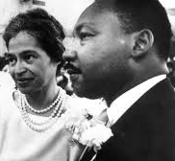


Slide 4
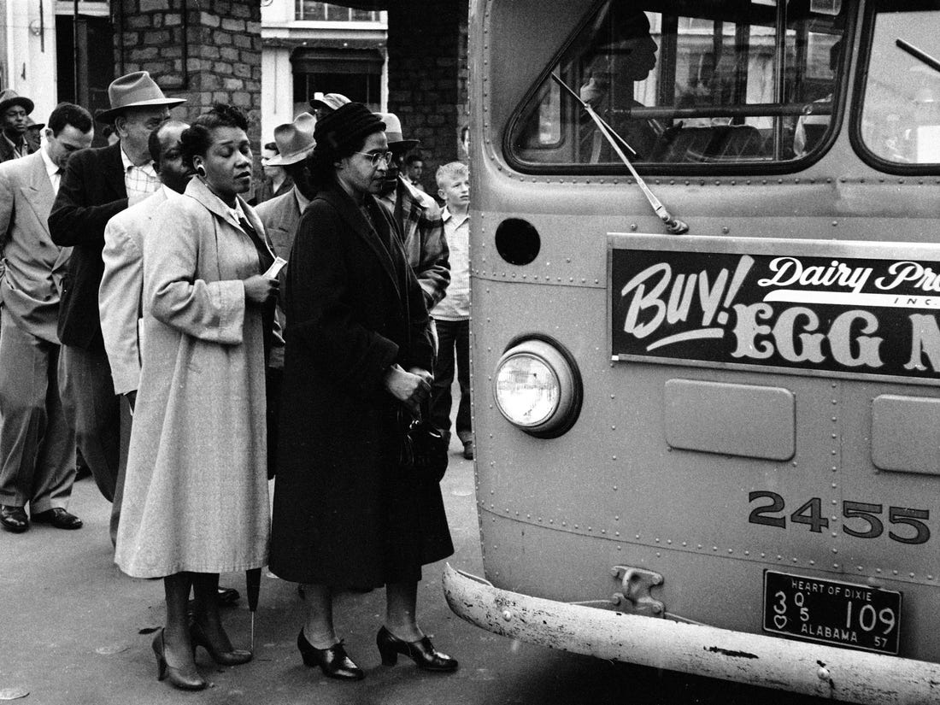
One day in December 1955, Mrs. Rosa Parks boarded a city bus in Montgomery, Alabama. She was tired from a busy day at work. She was tired of sitting in the back of the bus. But mostly, she was tired of the wrongness of things. It didn't make any sense. It had never made any sense.

Slide 5
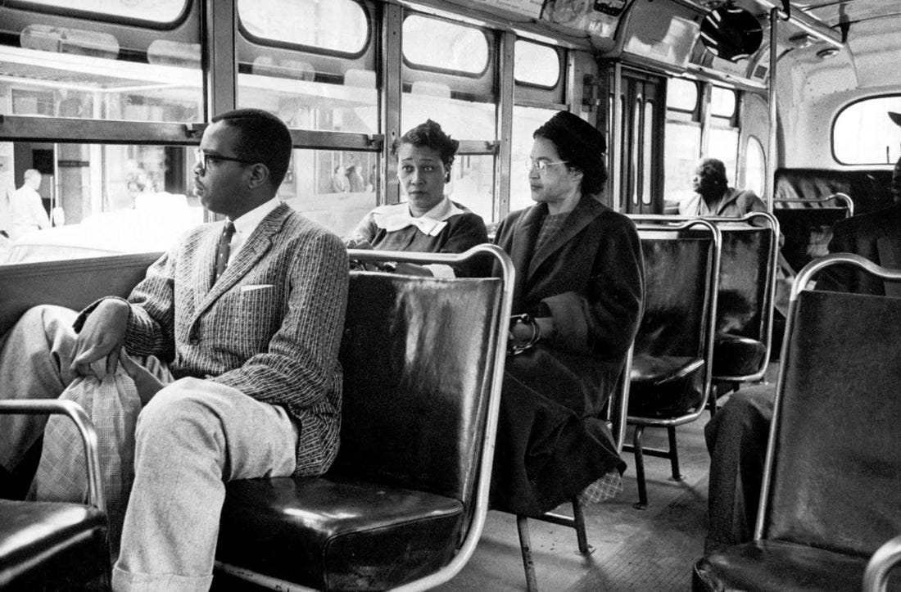

There was a law in Alabama that required persons of color to ride in the back of the bus and to give up their seat to a white person if the bus was crowded.

Slide 6
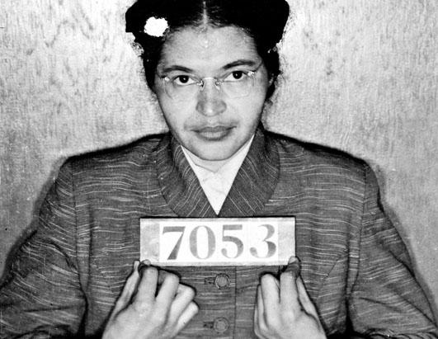
That day, when the bus driver told her to move to allow a white person to be seated, Mrs. Parks refused. She did not argue. She simply refused to get up and move. The bus driver called the police. The police took Mrs. Parks away to jail.

Slide 7
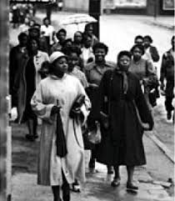
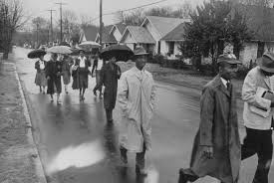
When Martin Luther King, Jr. heard that Mrs. Parks had been arrested, he called a meeting at his church. Dr. King believed there was something they could do. They could boycott. They could refuse to ride the buses. That would cost the city a lot of money.
It took 381 days for the boycott to work.

Slide 8
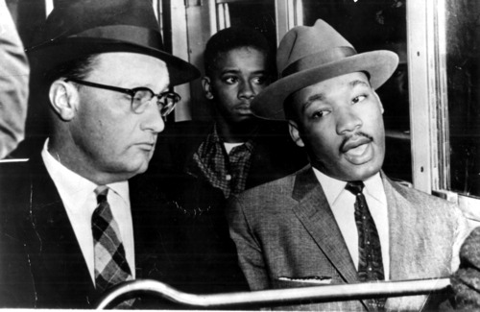
Finally, just over a year after the courageous Rosa Parks refused to give up her seat, a very good thing happened. A few days before Christmas, Dr. King, a black minister, and his good friend Reverend Smiley, a white minister, sat together on the front seat of a Montgomery city bus. The battle for equal rights under the law was not won. There were many battles ahead before the job would be done. But that was a most special morning.

Slide 9
